Slide 1

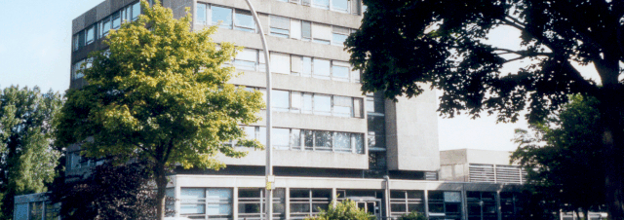
Simulation of CFRP elements heated by moving laser heat source in Abaqus
Suba Siva Chandran, Kalimuthu, 28.05.2021

Slide 2
Simulation of CFRP elements heated by moving laser heat source in Abaqus
Resin (0.001 mm)
Moving laser heat source is implemented in ABAQUS by FORTRAN subroutine DFLUX
Gaussian model describing the laser beam heat source is implemented based on research article “Application of Abaqus to analysis of the temperature field in elements heated by moving heat sources”
Moving laser heat source
2
Traversing
path
25
25
Simulation model setup
Material properties used:
 | Density (ton/mm³) | Sp.heat (mJ/ton K) | Conductivity (mW/mm²K)
Thermoset resin | 1,30e⁻⁹ | 1,1e⁹ | 2,5e⁻¹
Fiber | 1,60e⁻⁹ | 9,50e⁸ | 4,5 (longitudinal) 0,67 (transverse)

Slide 3
Simulation of CFRP elements heated by moving laser heat source in Abaqus
Steps carried out based on discussion from previous meeting:
Thermal conductivity was changed
Material parameters were checked
Connections of the parts and material orientations were checked
Temperature difference was studied based on the resin thickness
Thermal conductivity with same values are applied in both directions
Temperature differences based on resin thickness
k11 | k22 | k33
4,5 | 0,67 | 0,67
 | 1 micrometer | 10 micrometers | 50 micrometers
Thermoset resin | 508,103 | 446,628 | 435,75
CFRP | 508,104 | 446,929 | 441,693

Slide 4
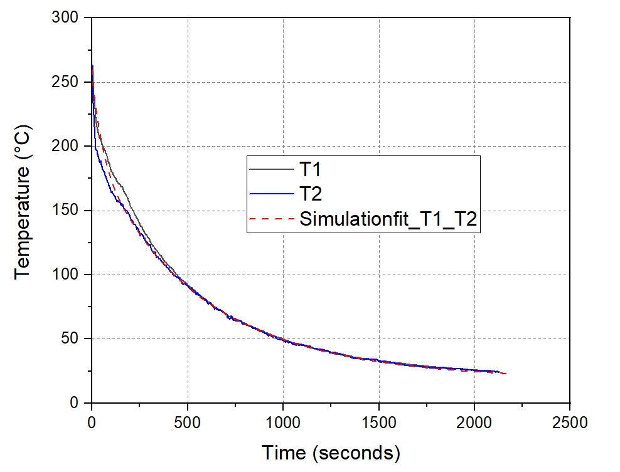
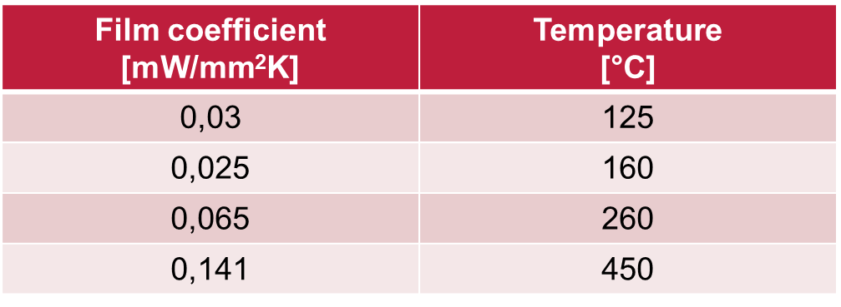
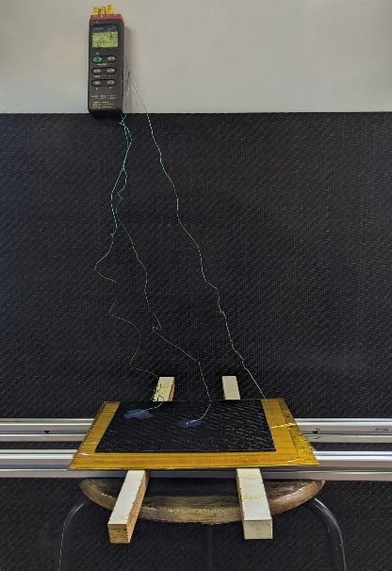
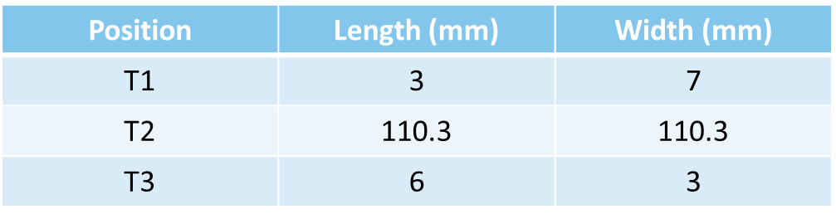
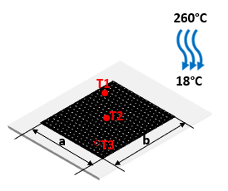
Simulation of CFRP elements heated by moving laser heat source in Abaqus
Steps carried out based on discussion from previous meeting:
Mesh is refined in the centre region where the heat source traverses through
Free convection from the model based on film coefficients
Increment size changed from 0.1 to 0.001
Temperature values were measured at same points for all the simulations
Geometry
a = 220.3 mm, b = 220.3 mm

Slide 5
Temperature values of Simulation attempts
Temperature values based on free convection and Increment size – 0.1
 | 1 micrometer | 10 micrometers | 50 micrometers
Thermoset resin | 411,17 | 400,313 | 351,67
CFRP | 411,376 | 402,687 | 369,446
Temperature values based on Increment size – 0.001 alone
 | 1 micrometer | 10 micrometers | 50 micrometers
Thermoset resin | 400,895 | 390,21 | 340,328
CFRP | 400,9 | 390,632 | 350,75
Temperature values based on free convection and Increment size – 0.001
 | 1 micrometer | 10 micrometers | 50 micrometers
Thermoset resin | 392,008 | 380,484 | 329,411
CFRP | 392,18 | 382,502 | 345,461

Slide 6
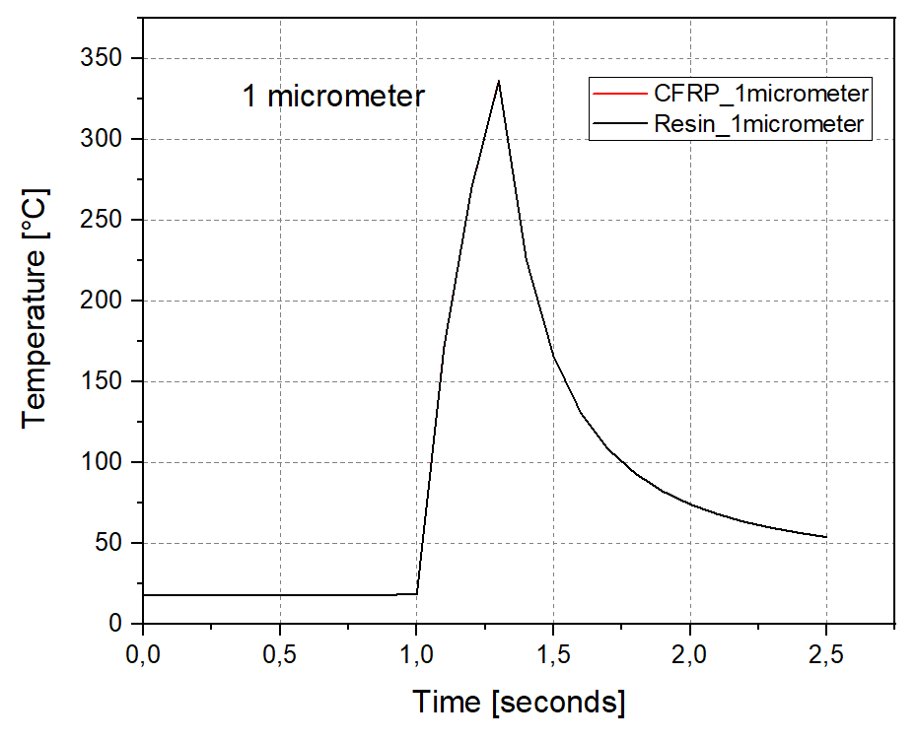
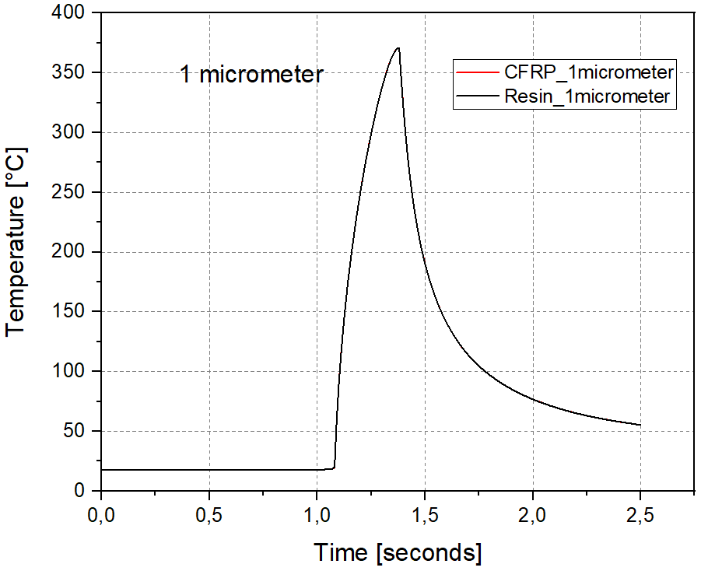
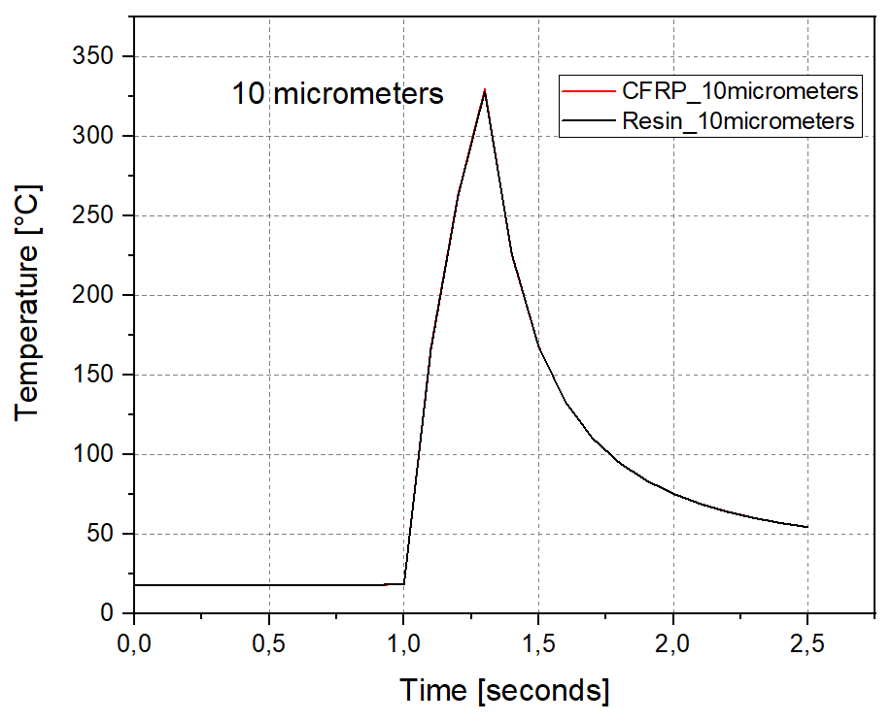
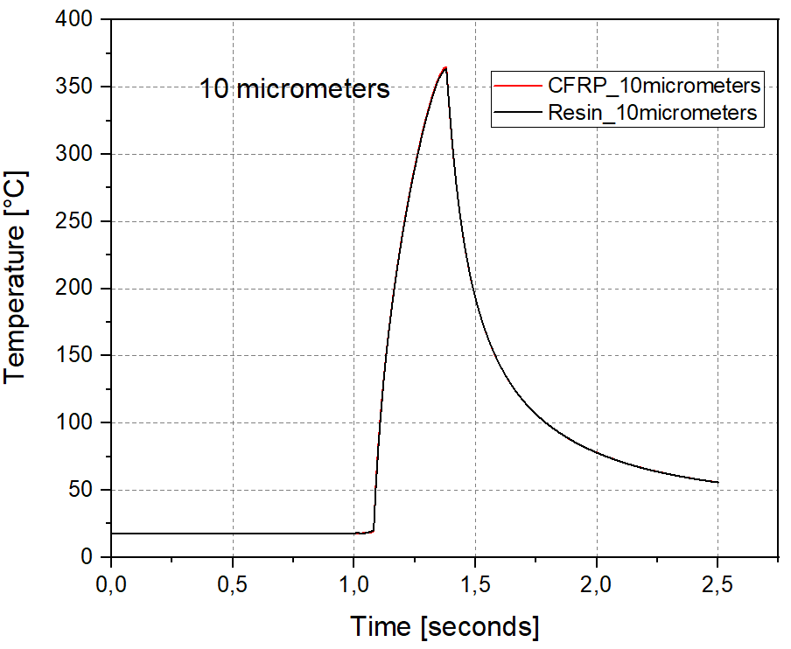
Temperature values of Simulation (New material props) – 28.05.2021
Inc size: 0.1
Inc size: 0.01

Slide 7
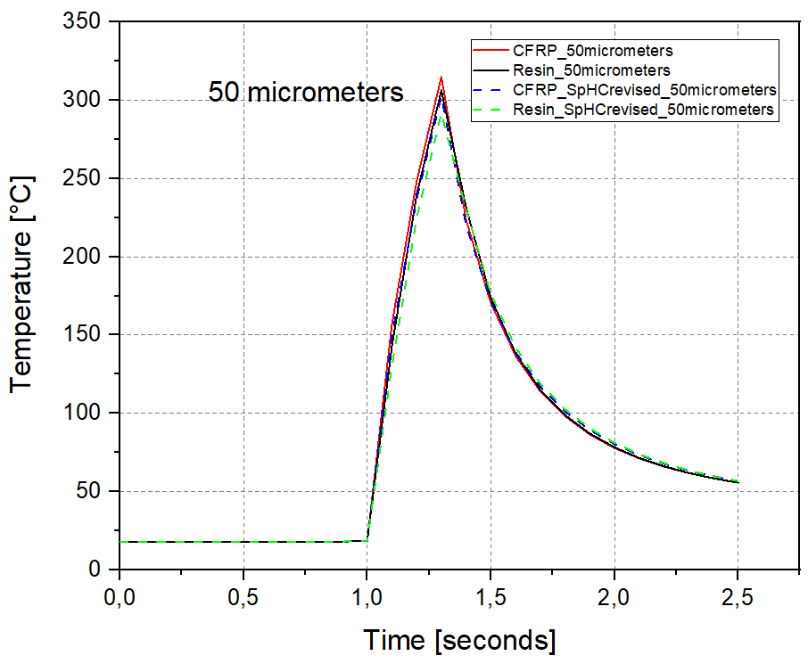
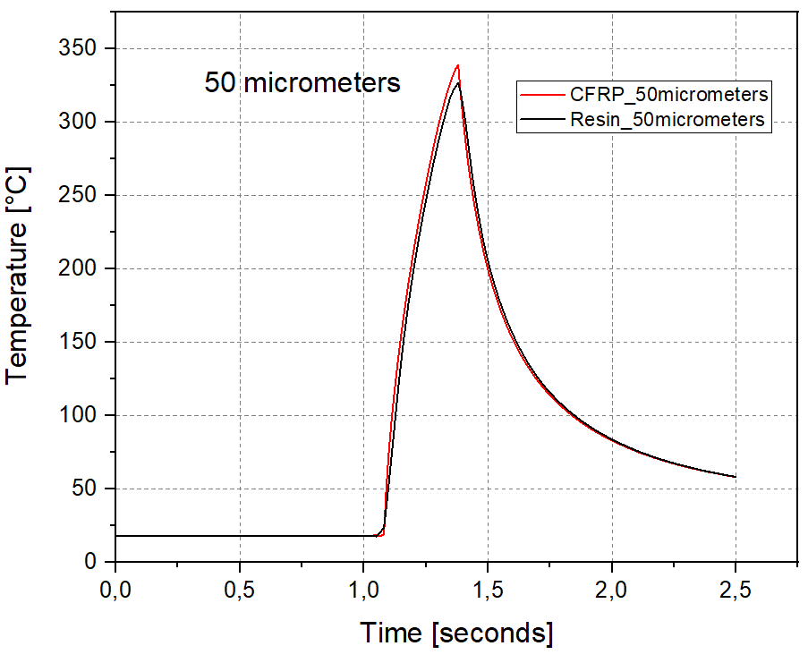
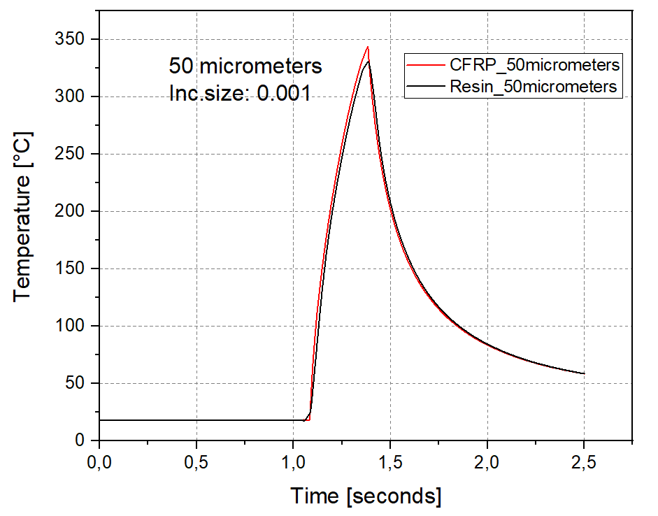
Temperature values of Simulation (New material props) – 02.06.2021
Inc size: 0.1
Inc size: 0.01
Inc size: 0.001

Slide 8
Temperature values of Simulation (New material props) – 28.05.2021
Temperature values based on free convection and Increment size – 0.1
 | 1 micrometer | 10 micrometers | 50 micrometers
Thermoset resin | 336,256 | 328,349 | 291,763
CFRP | 336,363 | 329,614 | 302,454
Temperature values based on free convection and Increment size – 0.01
 | 1 micrometer | 10 micrometers | 50 micrometers
Thermoset resin | 370,653 | 363,186 | 326,703
CFRP | 370,799 | 364,956 | 339,02

Slide 9
Temperature values of Simulation (New material props) – 02.06.2021
All the below values in the table correspond to 50 micrometers at different increments such as 0.1,0.01 and 0.001 respectively
 | 0.1 | 0.01 | 0.001
Thermoset resin | 291,763 | 326,703 | 330,702
CFRP | 302,454 | 339,02 | 343,859

Slide 10
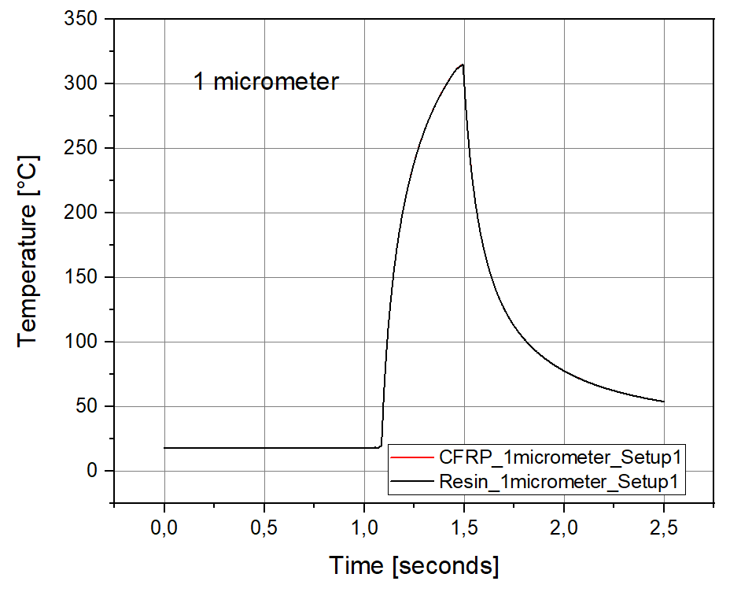
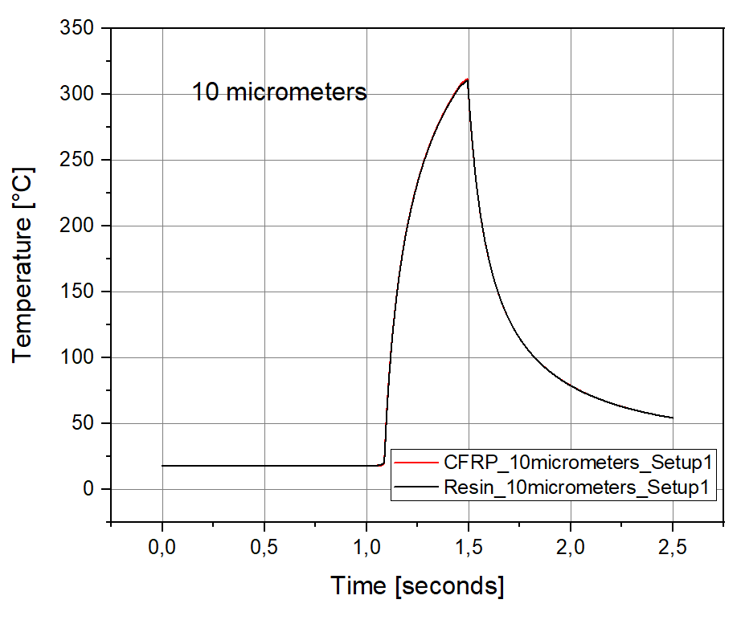
Temperature values of Simulation (1st Setup) – 05.07.2021
 | 1 micrometer | 10 micrometers
Thermoset resin | 314,988 | 310,508
CFRP | 315,088 | 311,778

Slide 11
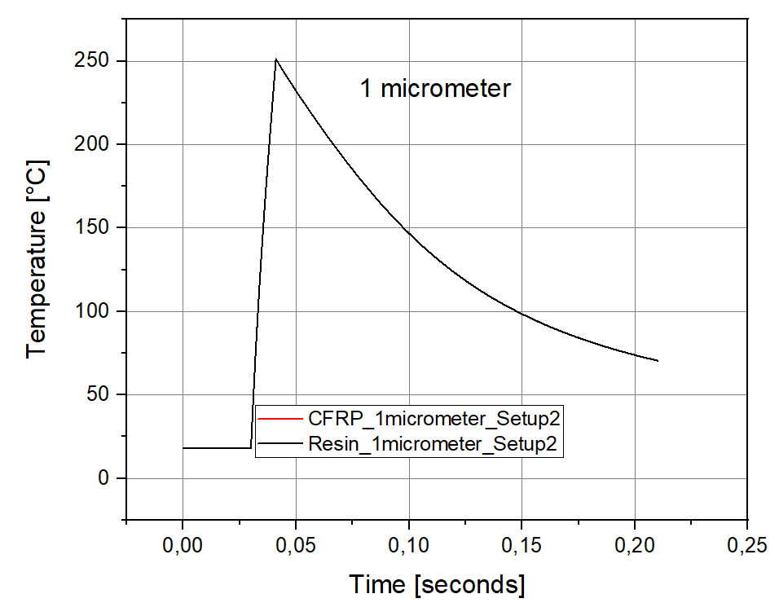
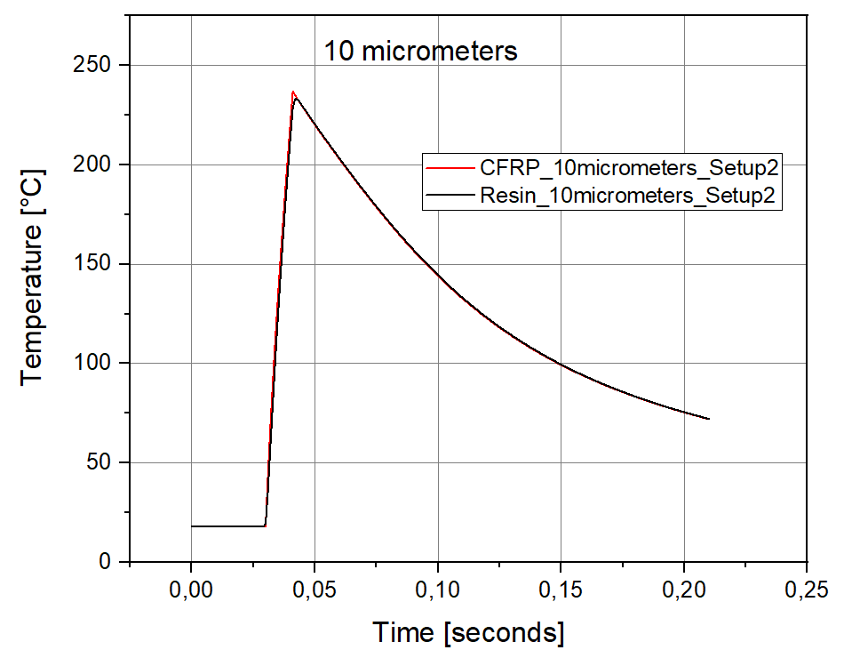
Temperature values of Simulation (2nd Setup) – 05.07.2021
 | 1 micrometer | 10 micrometers
Thermoset resin | 251,078 | 233,313
CFRP | 251,23 | 237,051

Slide 12
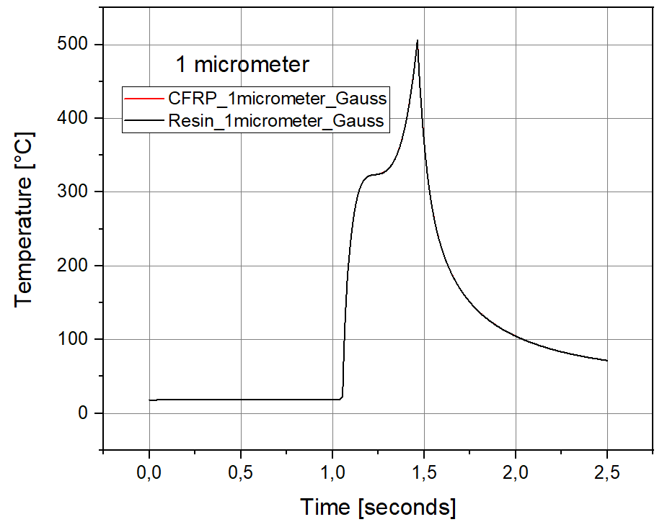
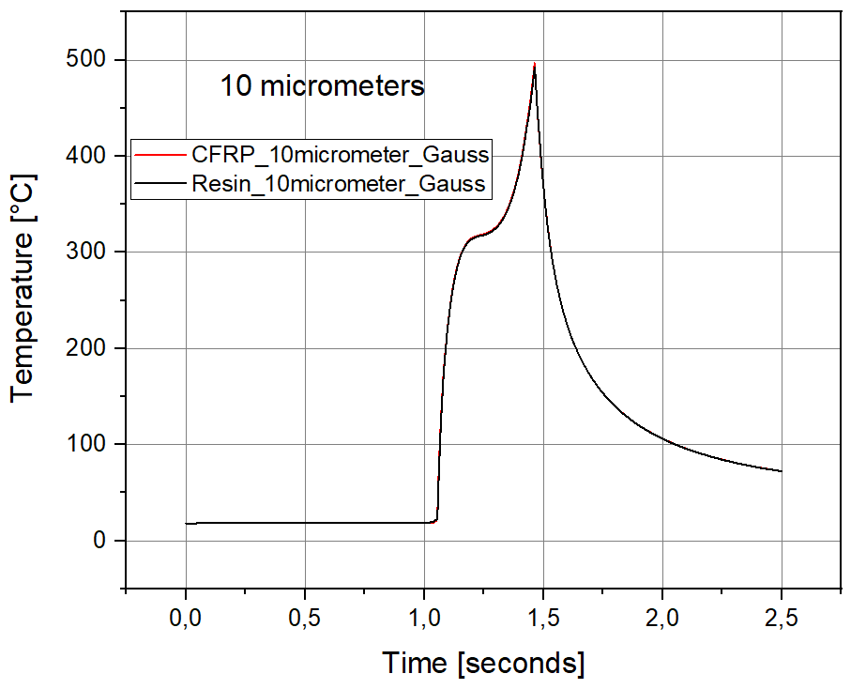
Simulation with Gauss profile (d = 4mm) – 01.08.2021
 | 1 micrometer | 10 micrometers
Thermoset resin | 505,827 | 492,241
CFRP | 506,098 | 496,651

Slide 13
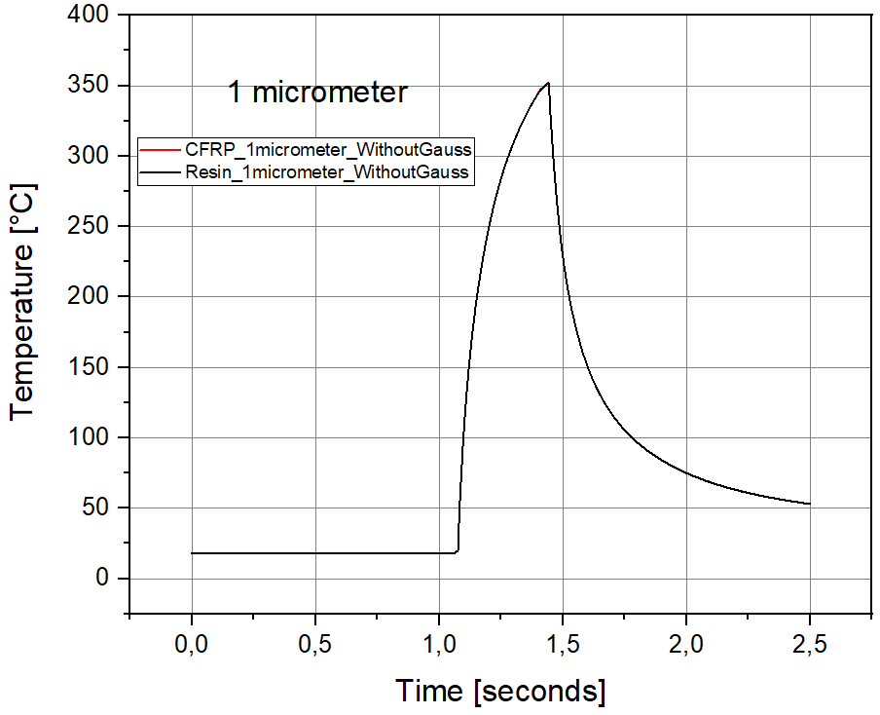
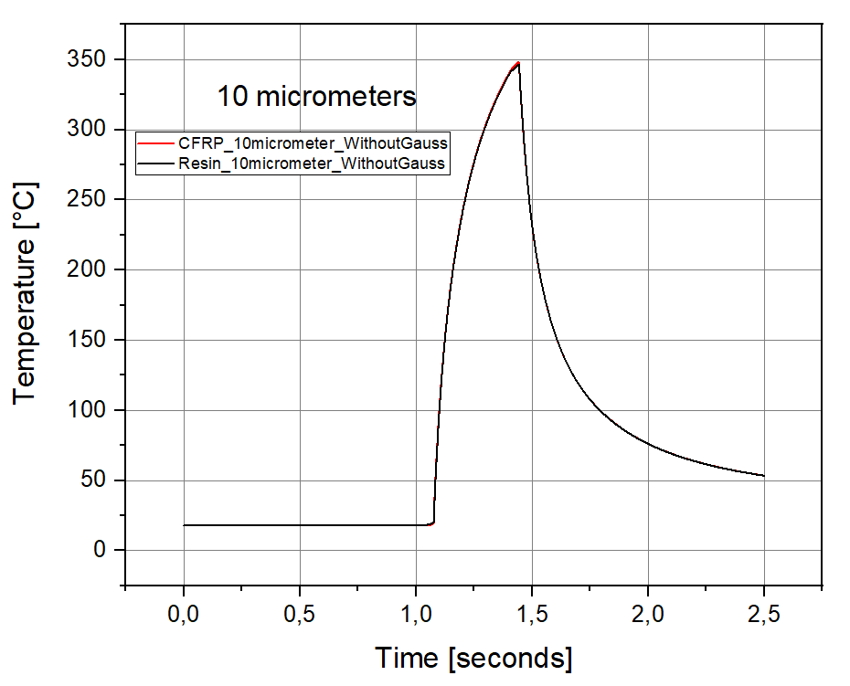
Simulation without Gaussian profile (d = 3.6 mm) – 01.08.2021
 | 1 micrometer | 10 micrometers
Thermoset resin | 351,827 | 346,458
CFRP | 351,96 | 348,103

